Slide 1

Collaborative filtering.
Alexey Osipov.

Slide 2

Statement of the problem.
U is a set of users, I is a set of items.
R = (r_{u, i}) are recommendations (binary or integer).
Goal: forecast non-filled cells.
Related tasks: cross-selling, up-selling from e-commerce.
Find relevant documents.

Slide 3
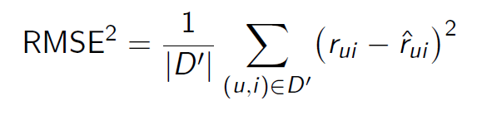
Quality measures.
Precision at k, recall at k, MAP at k, NDCG.
Diversity, novelty, coverage, serendipity, propensity.

Slide 4
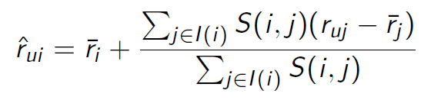
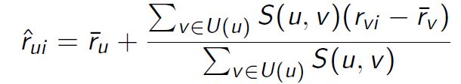
Non-parametric regression.
User-based CF:
Client-based CF:
S(i, j) is similarity measure (Pearson correlation, cosine similarity, Jaccard similarity, Fisher’s exact test)

Slide 5
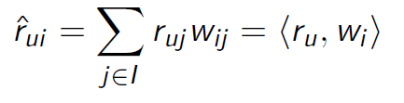
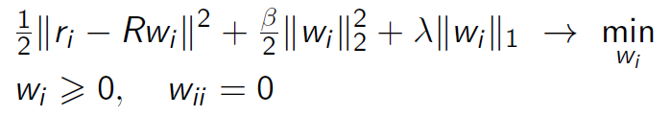
Sparse linear model.
It is possible to combine with similarity measure approaches.

Slide 6
Memory based (correlation methods).
Summary:
Easy to interpret and to implement.
They require storage of a large sparse matrix.
Cold start problem.
The recommendations can be trivial.

Slide 7

Matrix factorization (latent semantic models).
Methods:
Singular value decomposition.
Non-negative matrix decomposition.
Topic modelling.

Slide 8

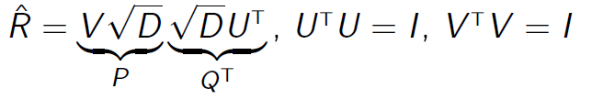
SVD
Components are non-interpretable.

Slide 9
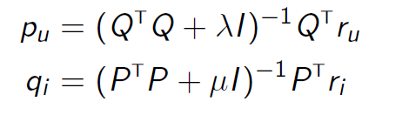
ALS (alternating least squares)
Prototyping a Recommender System Step by Step Part 2: Alternating Least Square (ALS) Matrix Factorization in Collaborative Filtering | by Kevin Liao | Towards Data Science

Slide 10
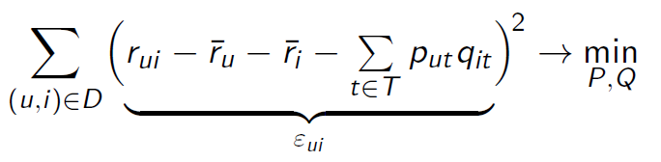
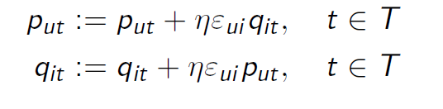
Latent factor model.
It is possible to add L^2-regularization.
It is possible to generalize for ranking problem.
One client/item/cell can be added easily.

Slide 11
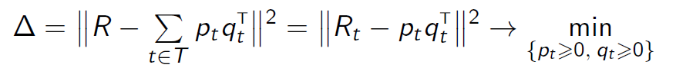
NNMF.
ALS for non-negative matrix decomposition:
We are searching p_t and q_t iteratively.

Slide 12
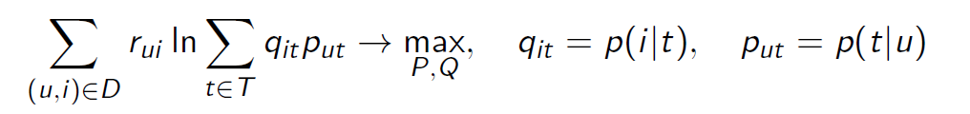
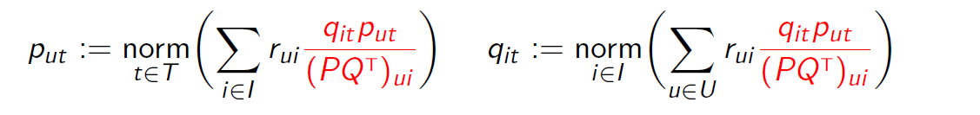
PLSA
Probabilistic latent semantic analysis.
EM-algorithm:

Slide 13
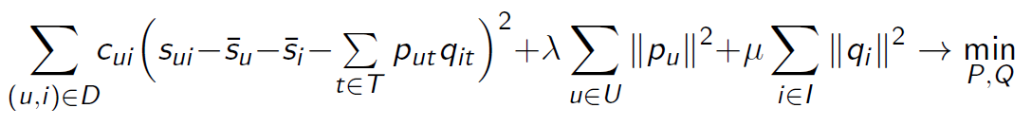

Implicit feedback model.
Explicit: purchase of item, like/unlike, rating (r_{u, i}).
Implicit: looked into the item page, saw part of the film (s_{u, i})
Winner of the Netflix Price.

Slide 14
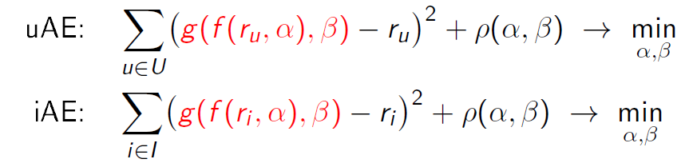
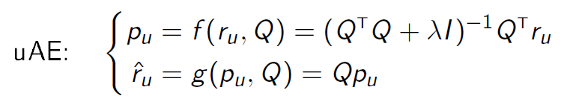
Auto-encoders.
User-based and item-based auto-encoders:

Slide 15
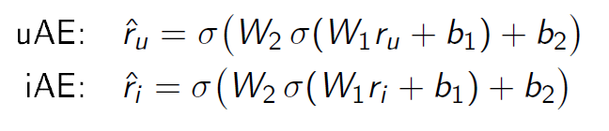
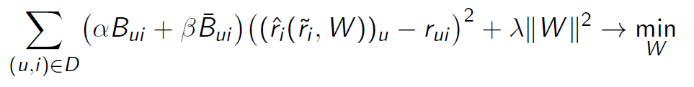
NN-based auto-encoders
Neural net based:
Denoising (some of the coordinates were set to 0, noise is \tilde{r})

Slide 16


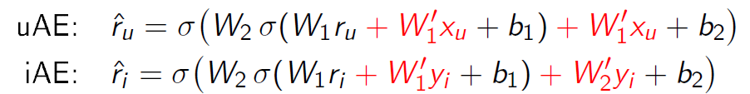
Usage of extra data in MF and autoencoders.
Note that x and y are features for clients and items.

Slide 17
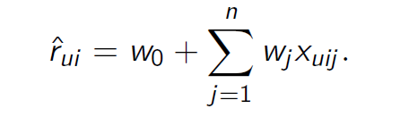
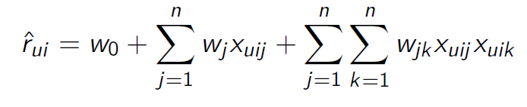

Usage of extra data in regression models.
Linear regression:
Quadratic regression:
libFM

Slide 18
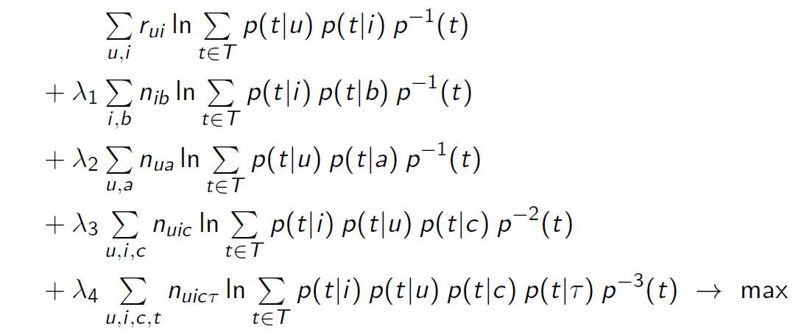
Usage of graph data.
Attribute aware, content aware, trust aware, context aware, time aware.

